Slide 1

OSYS2022
Scripting Basics

Slide 2
Stages to Creating a Script
Write the script
Make the script executable
Put the script where the shell can find it

Slide 3
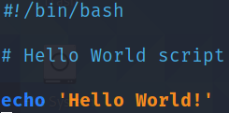
Write the Script
#!/bin/bash = Shebang
# Hello World script = Comment
echo ‘Hello World!’ = writes string to output

Slide 4
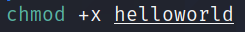
Make the Script Executable
File is missing the ‘x’, the permission required to execute the file and its contents
Add executable permission to the file for the owner, group, and others
Note the updated permissions and the colour-coding change in the filename

Slide 5
Script Location
~/bin = Scripts for personal use
/usr/local/bin = Scripts for any user on the system to use
/usr/local/sbin = Scripts for the system administrator

Slide 6
Script Location - $PATH
$PATH = Environmental variable of all directories searched by the system when attempting to execute a file
echo $PATH = Display contents of $PATH variable (~/bin not included by default)
Add ~/bin to $PATH (zsh)
In your home directory, create a file called ‘.zshenv’
Add the following line to the file and save the changes
Close and re-open your terminal for the changes to be loaded
Echo $PATH to confirm it is now listed

Slide 7
Stages to Creating a Script
Write the script
Shebang (#!/bin/bash)
Comments (#)
Commands
Make the script executable
New files lack executable permissions
chmod +x filename
Put the script where the shell can find it
~/bin
~/usr/local/bin
~/usr/local/sbin
$PATH

